Slide 1
Regularization Techniques in Regression Modeling.

Slide 2
OBJECTIVE OF THE ANALYSIS
Variables in Question:
The objective of this analysis is to estimate a linear regression model. Specifically, with data available regarding the aggregate production function for the United States manufacturing sector, a linear regression model for gross production will be estimated.
Gross Production (Y)
Capital (K)
Labor (L)
Energy (E)
Other Intermediate Materials (M)

Slide 3
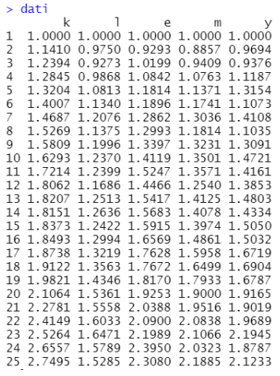
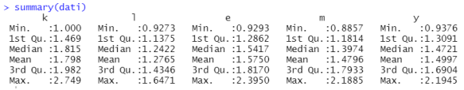
Data Matrix and Descriptive Statistics:

Slide 4
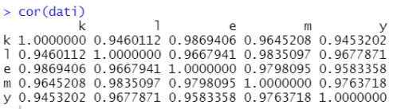
Check correlation between variables.
As a first step, we verify if there is a correlation between the variables through the correlation matrix:
From it, we can observe that they are highly correlated, thus we are in the presence of multicollinearity.

Slide 5
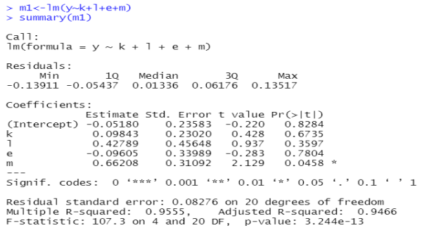
ESTIMATION OF REGRESSION COEFFICIENTS USING THE LEAST SQUARES METHOD.
From the Fisher test, having obtained a very small p-value result (3.244e-13), we can hypothesize that at least one of the regressors is significant. This hypothesis is confirmed by marginal tests from which it emerges that the only statistically significant regressor is m. Furthermore, as a consequence of multicollinearity, we can note that the values relating to the determination index are very high.

Slide 6
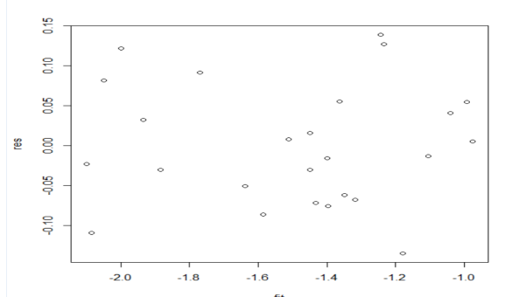
Check for the Presence of Heteroscedasticity.
The resulting graph is not very informative as the data are very scattered. The tests conducted lead to the following results:
BP Test: p-value = 0.9179
WHITE Test: p-value = 0.9665
In both cases, the null hypothesis of homoscedasticity is accepted.

Slide 7
The same operations will be carried out in three stages:
Logarithmic transformation of the dependent variable y;
Transformation of the linear model by dividing through the estimated ordinates;
Logarithmic transformation of the other variables;

Slide 8
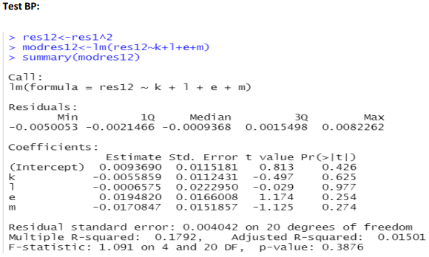
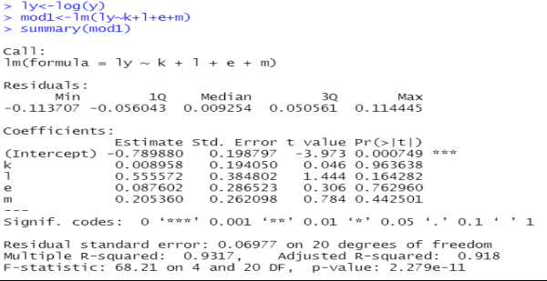
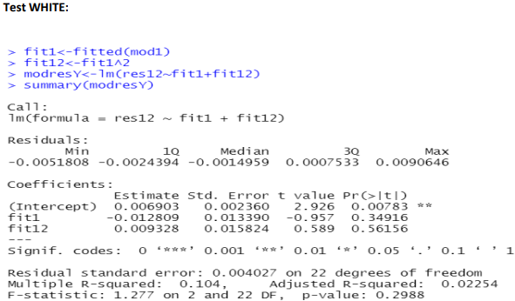
Model with logarithmic transformation of the dependent variable Y.
In this case too, the results obtained with both tests lead us to accept the null hypothesis of homoscedasticity.

Slide 9
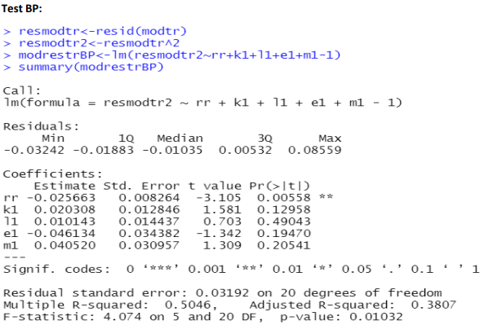
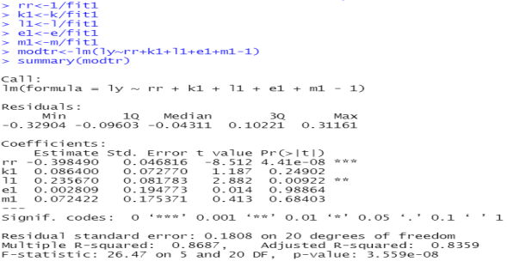
Transformation of the model by dividing by the estimated ordinates.
In this case, we reject the hypothesis of homoscedasticity.

Slide 10
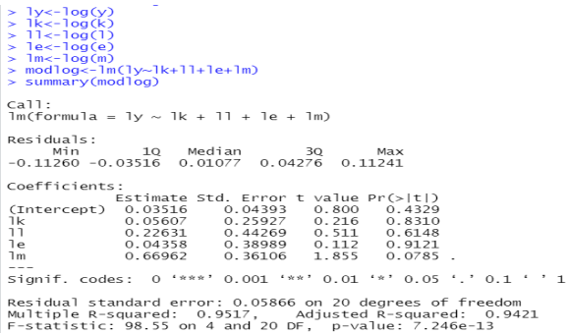
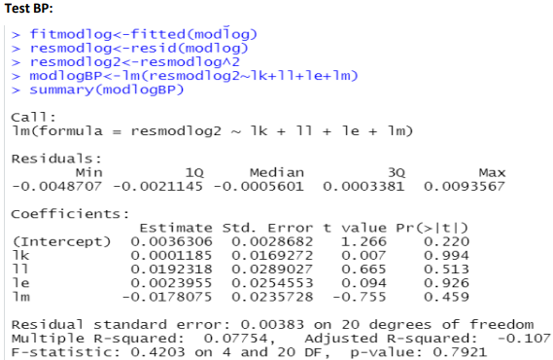
Model with logarithmic transformation of all variables.
In this case, we accept the hypothesis of homoscedasticity..
Since we have used the Cobb-Douglas production function, we cannot eliminate any regressor even if they appear not statistically significant in the model. Therefore, the final model would be:
log(y) = β1 * log(k) + β2 * log(l) + β3 * log(e) + β4 * log(m) + ε

Slide 11
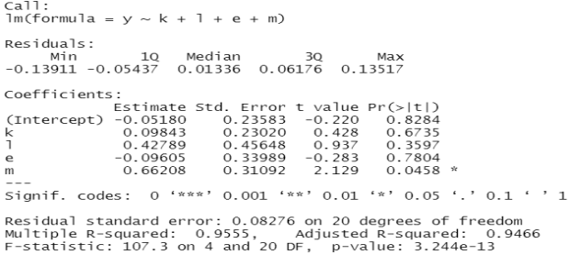
Estimation of the linear model with Dataset Split.
The objective is to construct the Training Set and Test Set to evaluate performance using MSE calculated by applying the learning model (model estimated with the Training Set) on the Test Set.

Slide 12
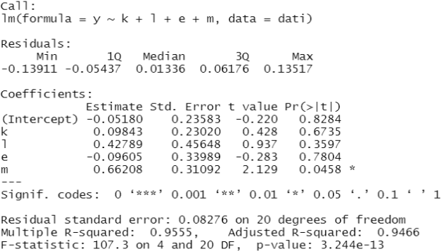
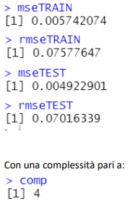
We estimate the training set for the learning model.
We introduce the MSE and RMSE functions and use them in the Train Set model:
It is superfluous to include interactions in the model, as they do not bring statistical improvements and, most importantly, negate the meaning of the production function.

Slide 13
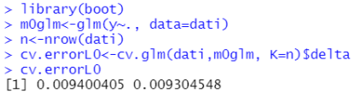

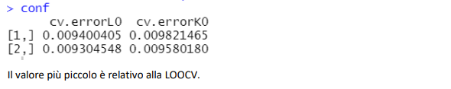



Cross Validation.
Leave-one—out Cross Validation
K-Fold Cross Validation
Confronto LOOCV e KFCV:
The smallest value is related to the LOOCV..

Slide 14
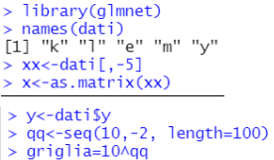
Estimation of Parameter λ in Ridge Regression
Splitting the dataset into matrix x and vector y and constructing the grid:

Slide 15
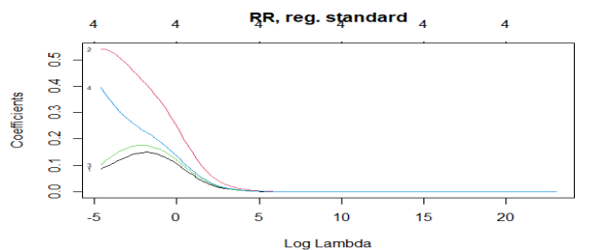

Estimating Ridge Regression with the entire dataset.
We notice that as λ increases, all parameters tend to zero; thus, the Ridge estimates coincide with those of least squares.

Slide 16
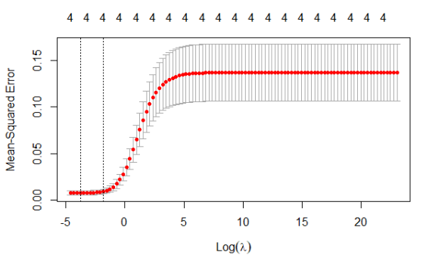


CROSS VALITATION CON glmnet().
Extracting the minimum lambda.
And we use the lambda corresponding to the minimum MSE to estimate the final model:

Slide 17
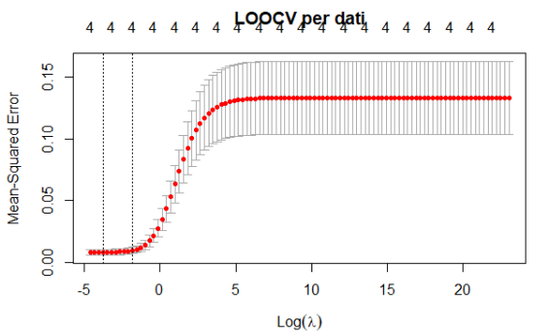


Best Lambda con LOOCV:
Best Lambda LOOCV.
Model with Best Lambda LOOCV
We notice that it identifies the same lambda, and the coefficients are also the same.

Slide 18
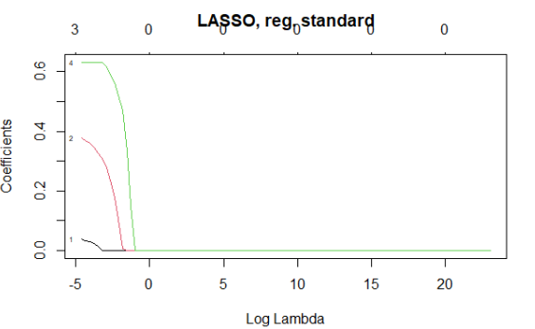


Lasso for comparison of results with Ridge Regression, setting α = 1.
Minimum lambda corresponding to the smallest MSE value:
Estimate the Lasso regression model with the minimum lambda:
We notice that here too, for small values of λ, it sets some coefficients to zero, particularly the coefficient e.

Slide 19
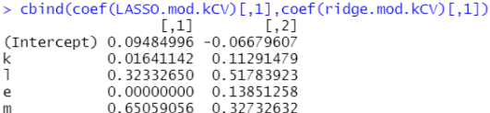
Comparison of parameter estimates between Lasso and Ridge:
The only coefficient set to zero is that of the regressor e. There are no sign changes, so they could be interpreted through ordinary least squares.

Slide 20
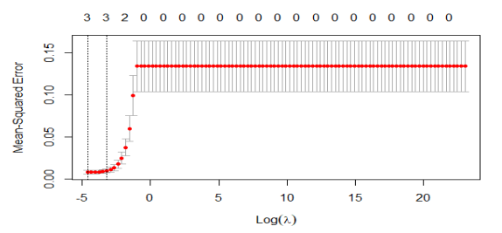
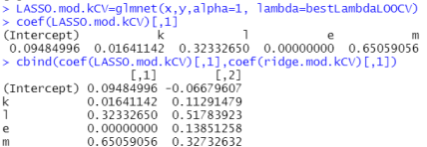
Now let's move on to LOOCV:
Best Lambda LOOCV Lasso:
Model with Best Lambda LOOCV Lasso:
In this case as well, the minimum lambda remains unchanged and is still 0.01, so it doesn't vary from the previous case.

Slide 21
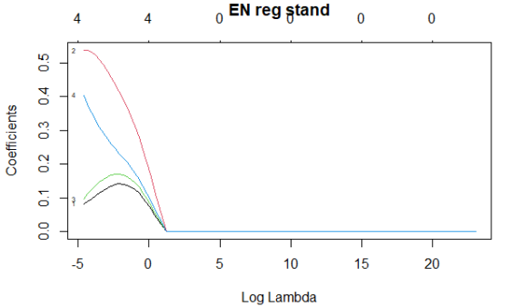
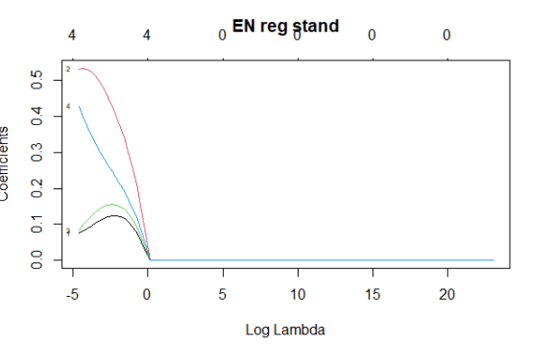
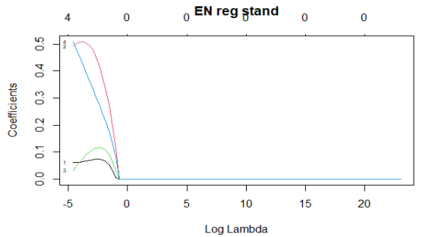
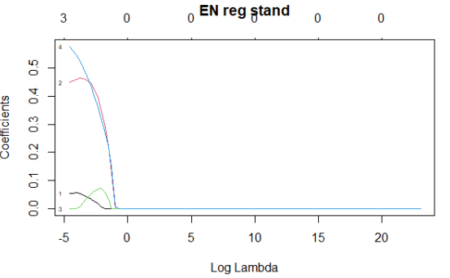
Application of Elastic Net and COMPARISON with Lasso and Ridge.
α=0.1
α=0.3
α=0.7
α=0.9

Slide 22
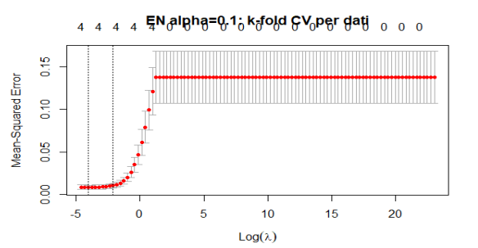


K-Fold Cross Validation Elastic Net.
α=0,1
BEST LAMBDA:
MODELLO CON BEST LAMBDA :

Slide 23
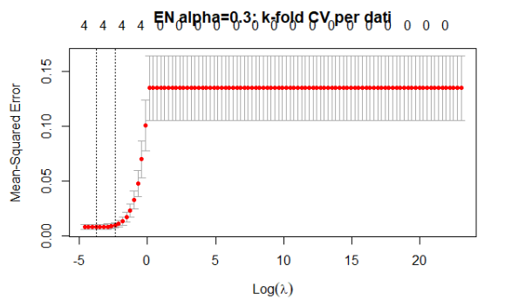


Let's do the same for the other levels of α.
α=0,3
BEST LAMBDA:
MODELLO CON BEST LAMBDA :

Slide 24
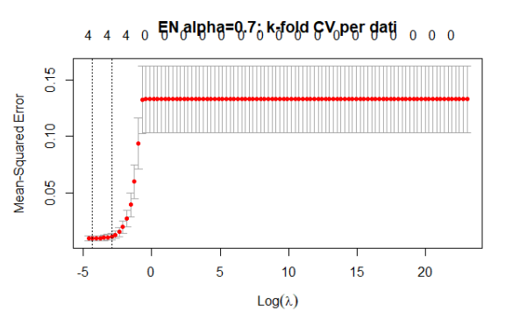


Let's do the same for the other levels of α.
α=0,7
BEST LAMBDA:
MODELLO CON BEST LAMBDA :

Slide 25
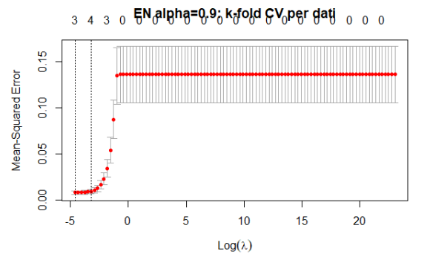


Let's do the same for the other levels of α.
α=0,9
BEST LAMBDA:
MODELLO CON BEST LAMBDA :

Slide 26
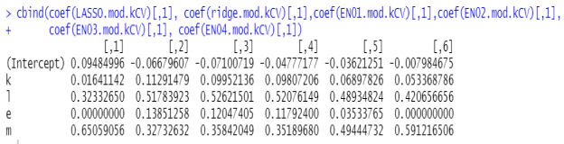



Now let's visualize all the coefficients for the various techniques to choose the model with the best MSE:
Among all the learning models, we choose the Ridge Regression model because it has a lower MSE.

